Slide 1

Deep Learning for Depth-Stratified Water Quality
Physics-Informed Modeling, Imputation, and Forecasting
Trieu H. Vo 1 Cuong V. Nguyen 2 Leonardo Bobadilla 1
1 Knight Foundation School of Computing & Information Sciences, Florida International University
2 Department of Mathematical Sciences, Durham University, UK
AI/ML Workshop • EWRI Congress, ASCE • Mobile, Alabama, 2025

Slide 2

Why Water Quality Monitoring Matters
Key Water Quality Variables
Temperature
Controls stratification, habitat, and reaction rates
Dissolved Oxygen (DO)
Determines fish survival; low DO triggers hypoxia
PAR (Light)
Drives photosynthesis and algal growth; decays with depth
Monitoring Infrastructure
Depth-stratified sensor buoys measure variables at multiple depths
High cost of deployment, maintenance, and calibration
Many water bodies remain entirely unmonitored
Goal: Build accurate AI models that fill data gaps and extend coverage beyond instrumented sites.
2 / 11
Reckhow (1994)

Slide 3

The Missing Data Challenge
DATA LOSS IN SENSOR NETWORKS
20–90%
THE CHALLENGE
No existing method addresses all failure modes while respecting physics.
1
2
3
Random Scattered
Sensor noise and transmission glitches.
3.7% – 13.8% missingness in Lake Mendota profiles.
Block Missing
Power outages, biofouling, or ice cover.
Offline for days to months; 94.8% loss in DO @ 0.0m.
Complete Missing
Sensors never installed at specific depths.
100% data loss for PAR @ 0.5m & 0.8m.
McAfee et al. (2025) • Lake Mendota (LakeBeD-US)

Slide 4
Physics of Stratified Water Bodies
THERMAL
OPTICS
Temperature & Stratification
Surface mixed layer (0–2 m): gradual variation
Thermocline: sharp gradient with depth
Strong seasonal cycle (4–25 °C)
Light Attenuation
• PAR decays exponentially with depth
PAR(z) = PAR(0) · e^(−Kd · z)
z = depth (m), K_d = attenuation coeff.
COUPLING
CHEMICAL
Cross-Variable Coupling
Temperature governs DO capacity
Light drives photosynthesis & DO production
Mixed layer maintains smooth profiles
DO Saturation Limit
• DO capacity is temperature-dependent
0 ≤ DO ≤ DOsat(T)
DO cannot exceed physical saturation
Garcia & Gordon (1992) • Kirk (2011)

Slide 5

Koopman Embeddings Reduce Forecasting Error by 70%
Transforming nonlinear lake dynamics into linear representations via Koopman operator theory.
Prediction Error Reduction
70%
Data Scale
40 Years of Daily Temp
450 Midwest U.S. Lakes
01
02
03
Koopman Encoder
Maps multi-depth temperatures into a 32-dimensional embedding space.
Seasonal Features
Combines embeddings with sine/cosine day-of-year features to capture cyclic trends.
4-Layer LSTM
Predicts next-step temperatures using a sliding window architecture.
Geneva & Zabaras (2022) • Willard et al. (2021) • Vo et al. (2025)

Slide 6



Axis-Factored Attention Architecture
Specialized attention blocks decomposing multi-dimensional imputation for depth, feature, and time.
Block C
DEPTH
Block Z
FEATURE
Block B
TIME
Learns vertical structure and interpolates across adjacent depth layers.
Captures cross-variable relationships between Temp, DO, and PAR.
Captures seasonal dynamics via gated convolution and self-attention.
Model Performance (MAE)
TEST CONFIGURATION
LakeBed-MN • Rate = 0.2 • Seq = 192
Includes calendar features & self-supervised masking training.
Lerp
0.337
CSDI
0.133
SAITS
0.133
DMI (ours)
0.114
DMI (ext)
0.091

Slide 7


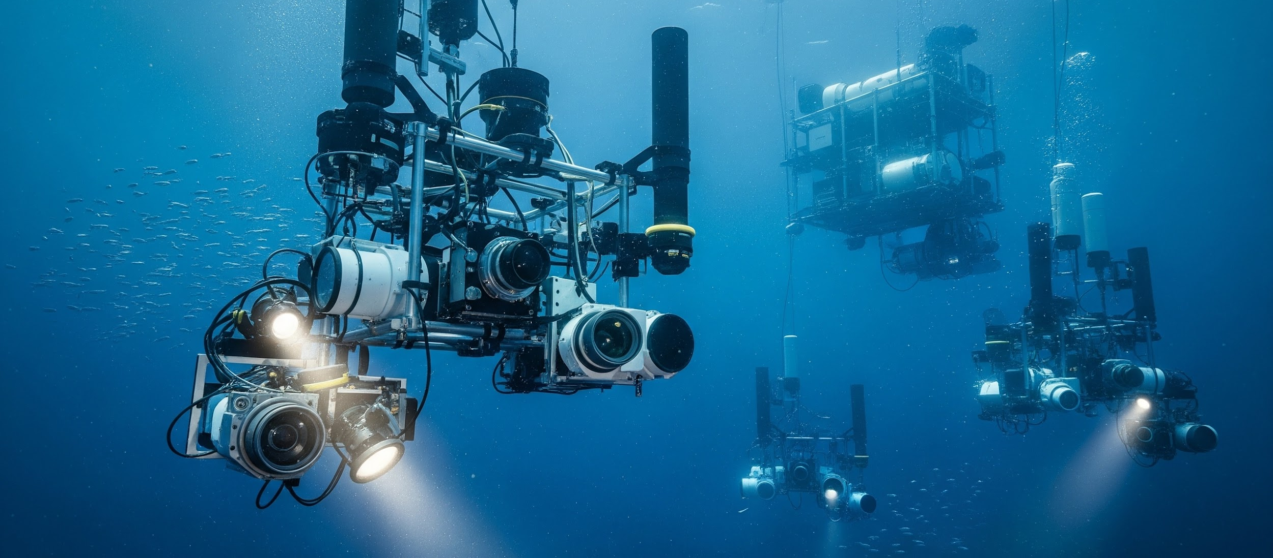
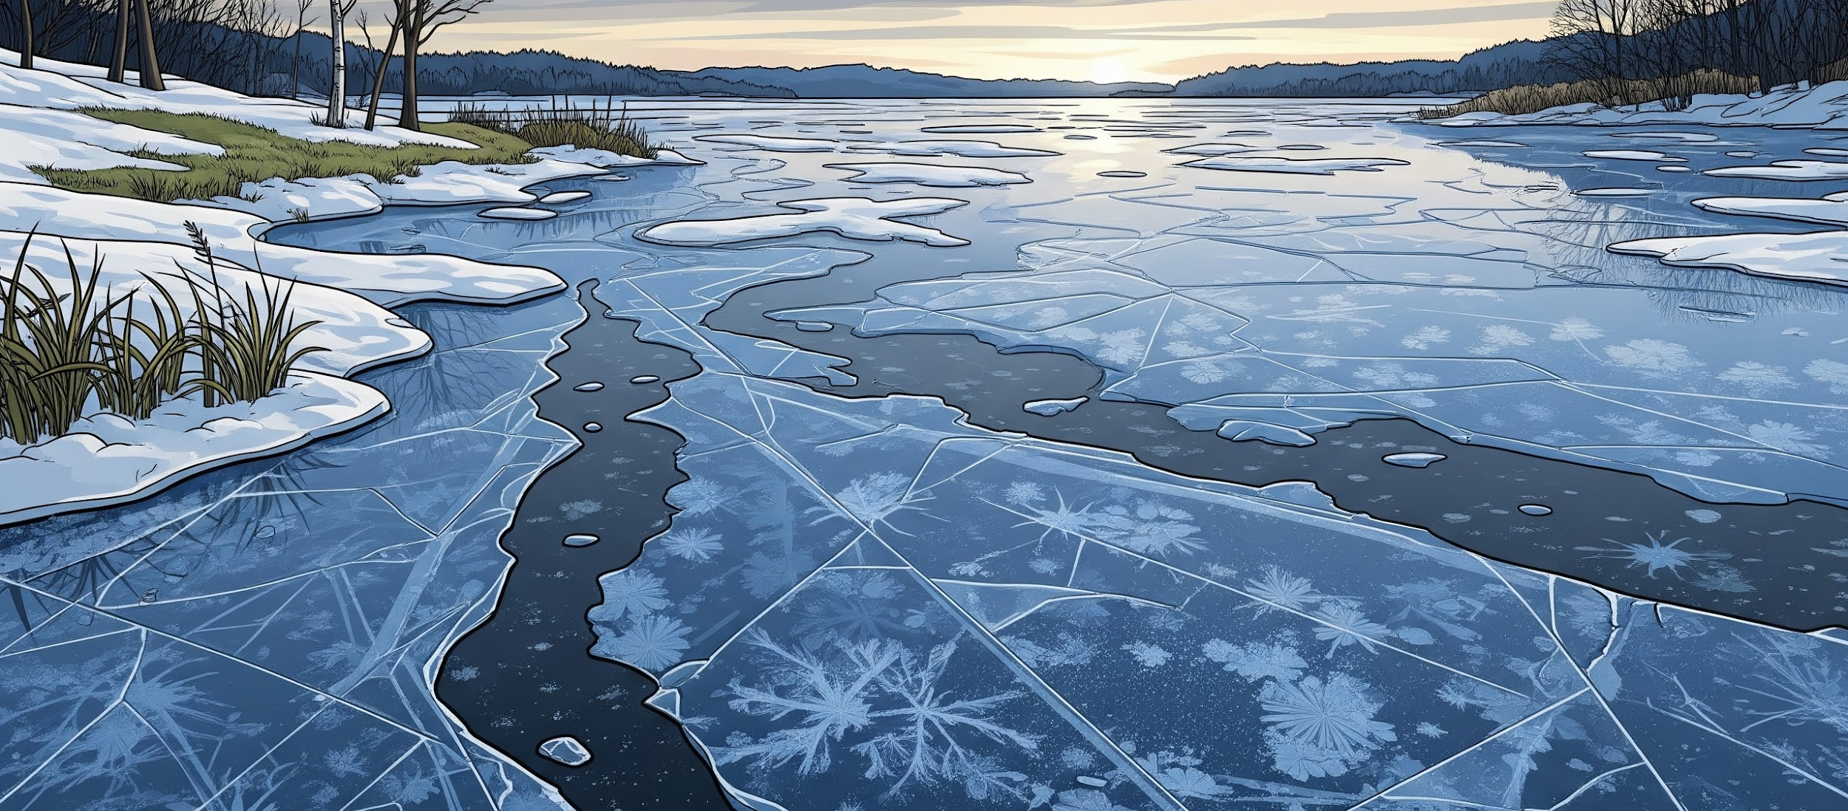
Robust Imputation Strategies for Sensor Failures
Each missing-data pattern leverages a dedicated mechanism to maintain high-fidelity reconstruction.
SCATTERED
INTERVAL
SPATIAL
CYCLIC
Random
Caused by sensor noise or transmission glitches. Handled via Bernoulli masking during training.
Block Missing
Power outages or biofouling lasting days to weeks. Uses temporal gradient & channel weighting.
Complete Missing
Sensor not installed at depths. Solved via depth-first prefill and physics loss supervision.
Seasonal Gaps
Winter ice cover (3-5 months). Leverages calendar features with semi-annual sine/cosine.
Metric Impact
Baseline
Performance
Prevents Flat Outputs
Mechanism
No Ground Truth
MAE Reduction
↓ 19.5%

Slide 8




Integrating Physical Laws into Model Training
Differentiable physics constraints in the training loss (λ = 0.01) provide supervision without ground truth.
CONSTRAINT
CONSTRAINT
CONSTRAINT
CONSTRAINT
DO Saturation
PAR Decay
Non-negativity
Depth Smoothness
DO ≤ DO_sat(T)
PAR(z)=PAR(0)e⁻ᴷᵈᶻ
Temp, DO, PAR ≥ 0
Δ(z₁, z₂) ≈ small
Prevents oxygen levels from exceeding physical maximums.
Ensures light intensity decreases exponentially with depth.
Enforces reality where physical quantities cannot be negative.
Prevents abrupt, non-physical jumps between depth layers.
KEY INSIGHT
For 100% missing channels, physics constraints provide the only training signal, allowing reconstruction without direct ground truth.
Karpatne et al. (2022) • Garcia & Gordon (1992) • Kirk (2011)

Slide 9
DMI Reduces Imputation Error by 32% Over Best Existing Methods
Multi-Depth Temperature Forecasting
Imputation Benchmark
LakeBed-MN (Rate=0.2, Seq=192)
Model
Depth
MSE
Method
MAE
RMSE
LSTM
0 m
36.31
Lerp
0.337
0.425
LSTM + Koopman
0 m
11.12
CSDI
0.133
0.185
LSTM
Overall
35.68
SAITS
0.133
0.181
LSTM + Koopman
Overall
10.80
ImputeFormer
0.255
0.336
iTransformer
0.344
0.431
DMI (ours)
0.114
0.286
DMI (extended)
0.091
0.201
Consistent 70% error reduction at every depth
Du et al. (2023) • Tashiro et al. (2021) • Nie et al. (2024) • Liu et al. (2024)

Slide 10

Future Directions and Research Vision
Next Steps
Practical Impact
• Diffusion-based generative modeling — single model for imputation & forecasting with calibrated uncertainty
• Multi-lake spatial graphs — propagate representations across lake networks
• Transfer to unmonitored sites — meta-learning from data-rich to data-scarce water bodies
• Recover missing data from degraded sensor networks
• Early warning for hypoxia and harmful algal blooms
• Reduce monitoring costs via intelligent imputation
• Support data-driven environmental policy
Long-term vision: a universal aquatic foundation model spanning lakes, rivers, and coastal zones.
Lopez Alcaraz & Strodthoff (2023)

Slide 11
References
[1]
McAfee et al. (2025)
LakeBeD-US: Benchmark Dataset
Earth Syst. Sci. Data.
[2]
Garcia & Gordon (1992)
Oxygen Solubility in Seawater
Limnol. Oceanogr.
[3]
Kirk (2011)
Light and Photosynthesis
Cambridge.
[4]
Geneva & Zabaras (2022)
Transformers for Physical Systems
Neural Networks.
[5]
Willard et al. (2021)
Predicting Water Temp. Lakes
Water Resour. Res.
[6]
Du et al. (2023)
SAITS: Imputation for Time Series
Expert Syst. Appl.
[7]
Tashiro et al. (2021)
CSDI: Diffusion Models
NeurIPS.
[8]
Nie et al. (2024)
ImputeFormer: Transformers
KDD.
[9]
Liu et al. (2024)
iTransformer: Inverted Transformers
ICLR (Spotlight).
[10]
Karpatne et al. (2022)
Physics-Guided Neural Networks
Chapman & Hall.
[11]
Lopez Alcaraz & Strodthoff (2023)
Diffusion-based Imputation
TMLR.
[12]
Vo et al. (2025)
Water Modeling Using PINNs
ICLR Workshop.
[13]
Reckhow (1994)
Water Quality Simulation
Ecol. Model.

